Slide 1


Slide 2
Slide for video

Slide 3

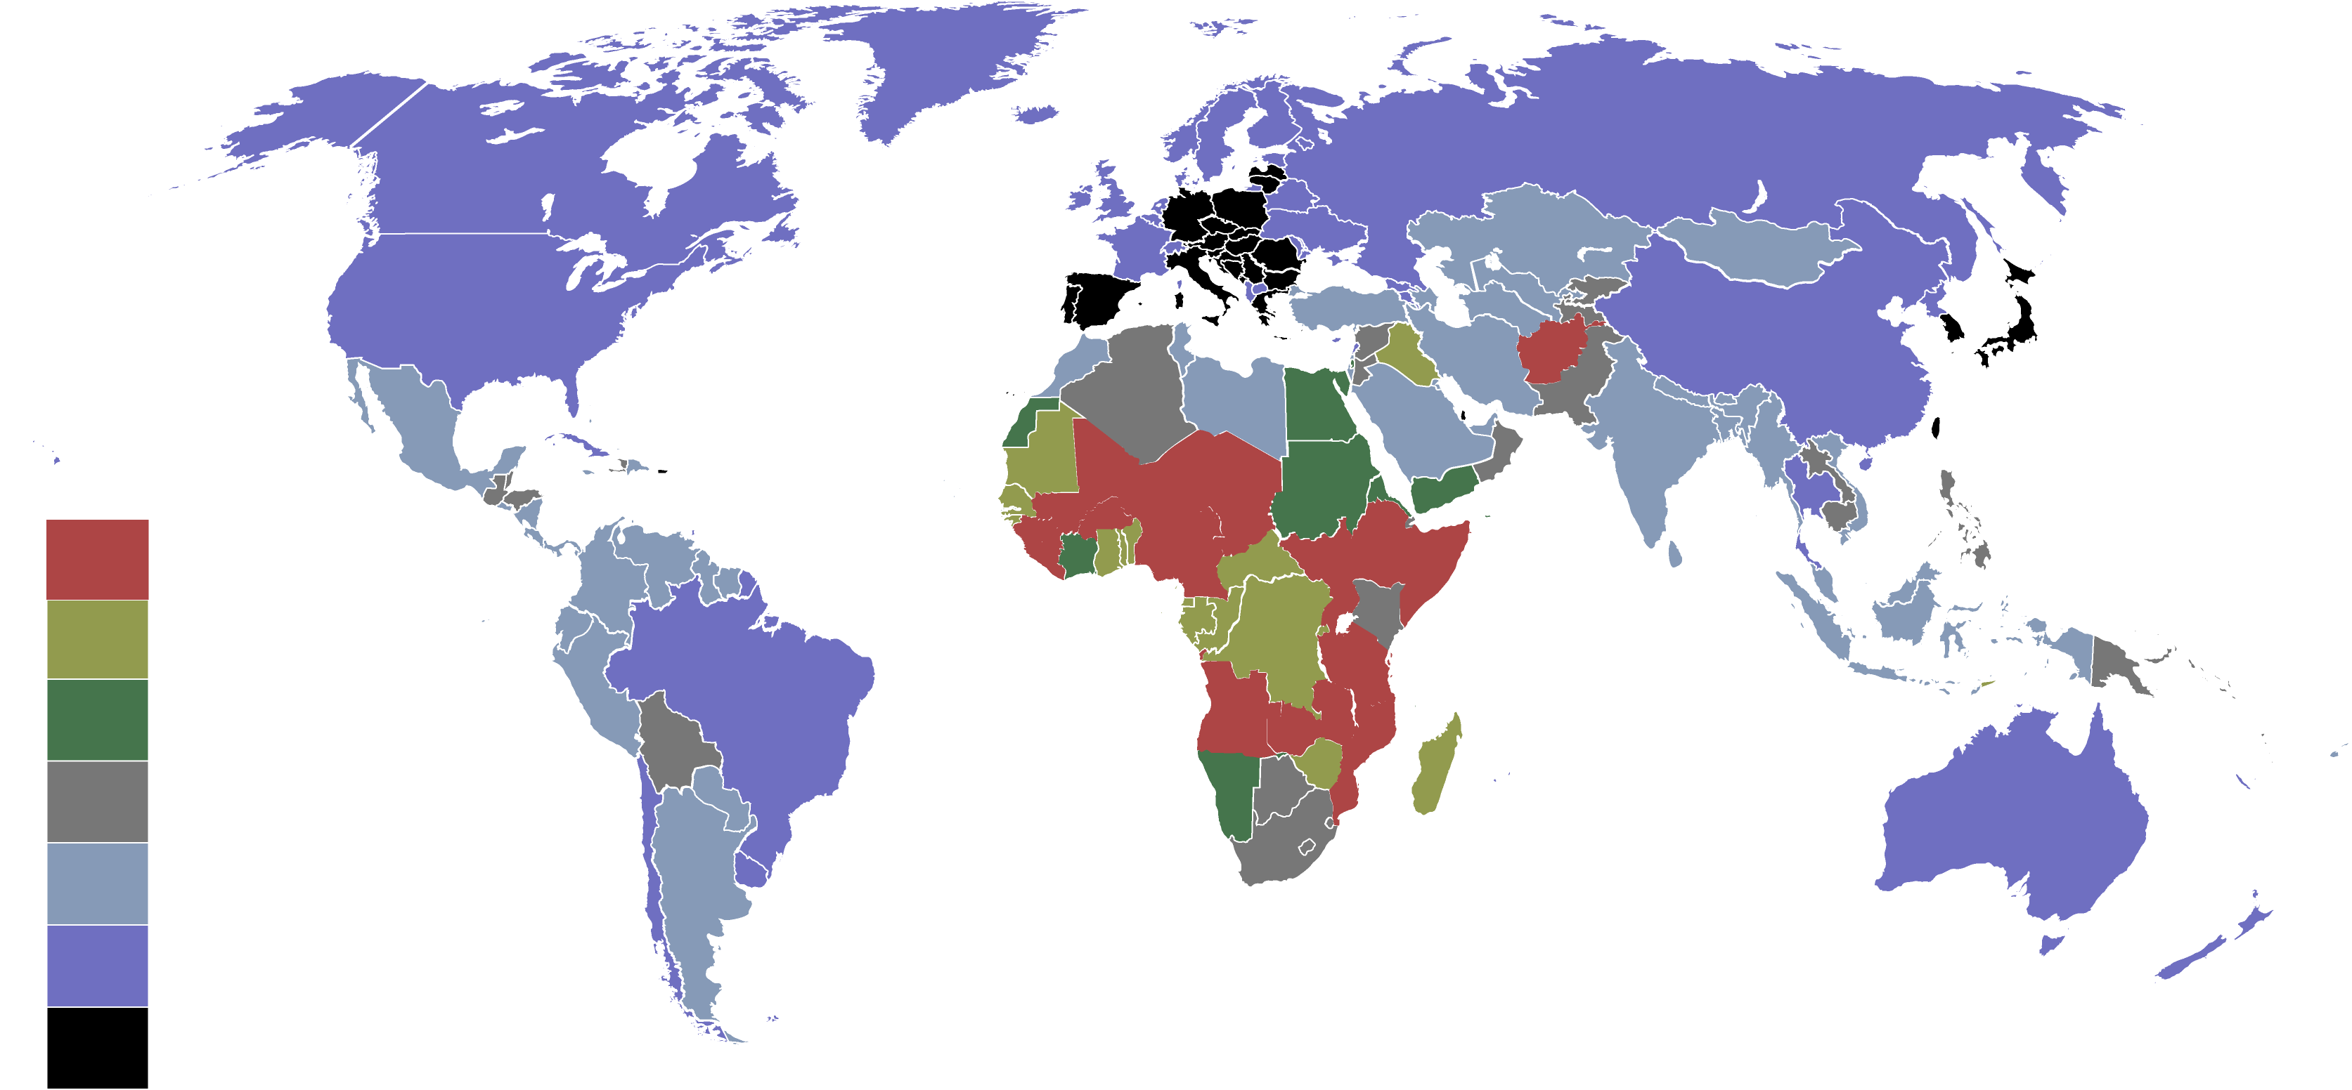
Countries by birth rate in 2017

Slide 4

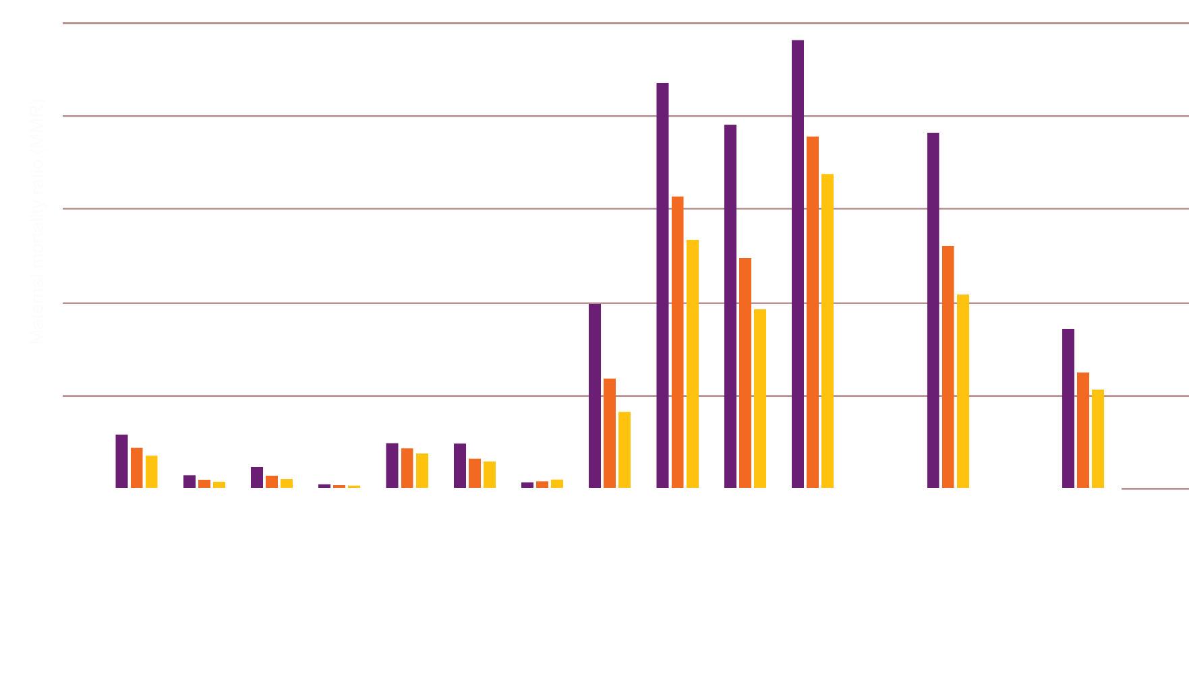
Maternal Mortality ratio
2000
2010
2017

Slide 5

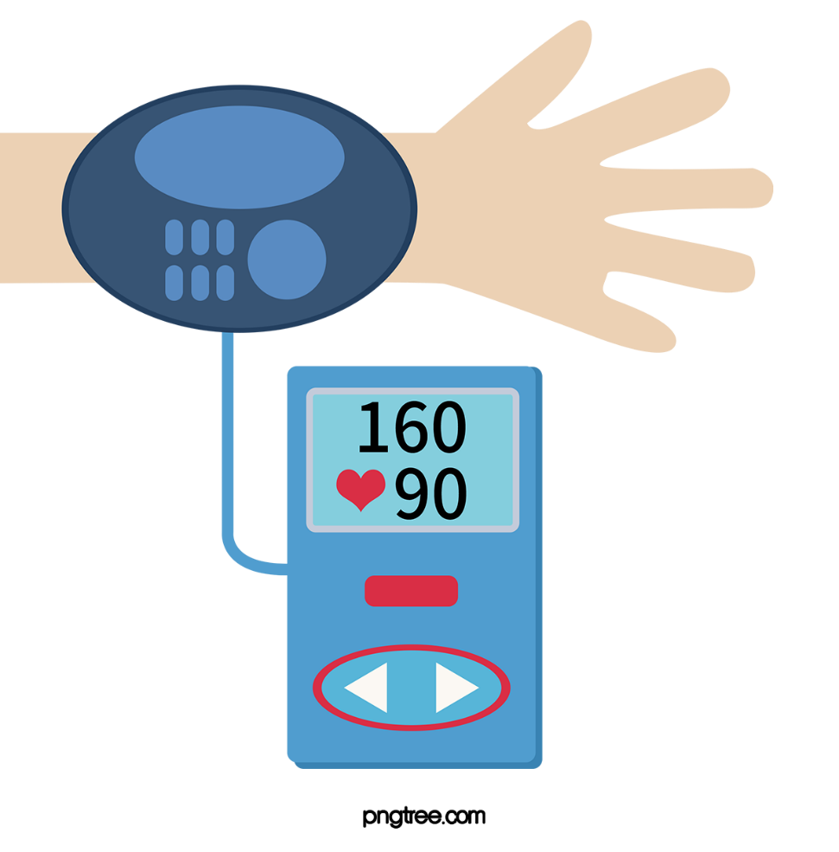
Problems
Scheduled Monitoring of body temperature, bpm and blood pressure could not be done.

Slide 6
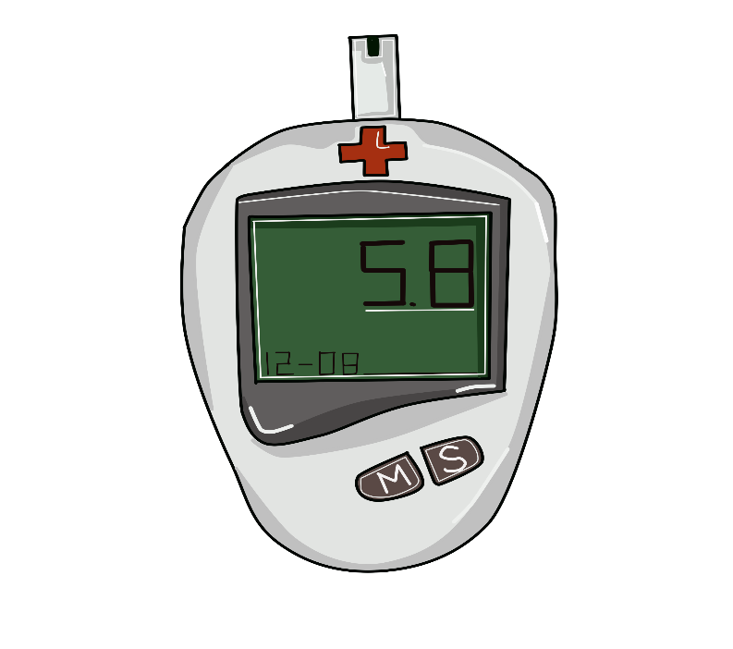
Lack of proper monitoring of glucose level can hamper a pregnant woman and her child.

Slide 7

Medicine specially anti biotics need to take in proper time. If it does not than it could develop anti resistant for a disease.

Slide 8

Proper nutrition taking is a must for pregnant woman and her child's health.

Slide 9





Steps we need to take
Continuous monitoring of temperature
Scheduled monitoring of glucose level
Scheduled monitoring of bpm and blood pressure
Maintaining schedule for medicine
Emergency service

Slide 10


Slide 11
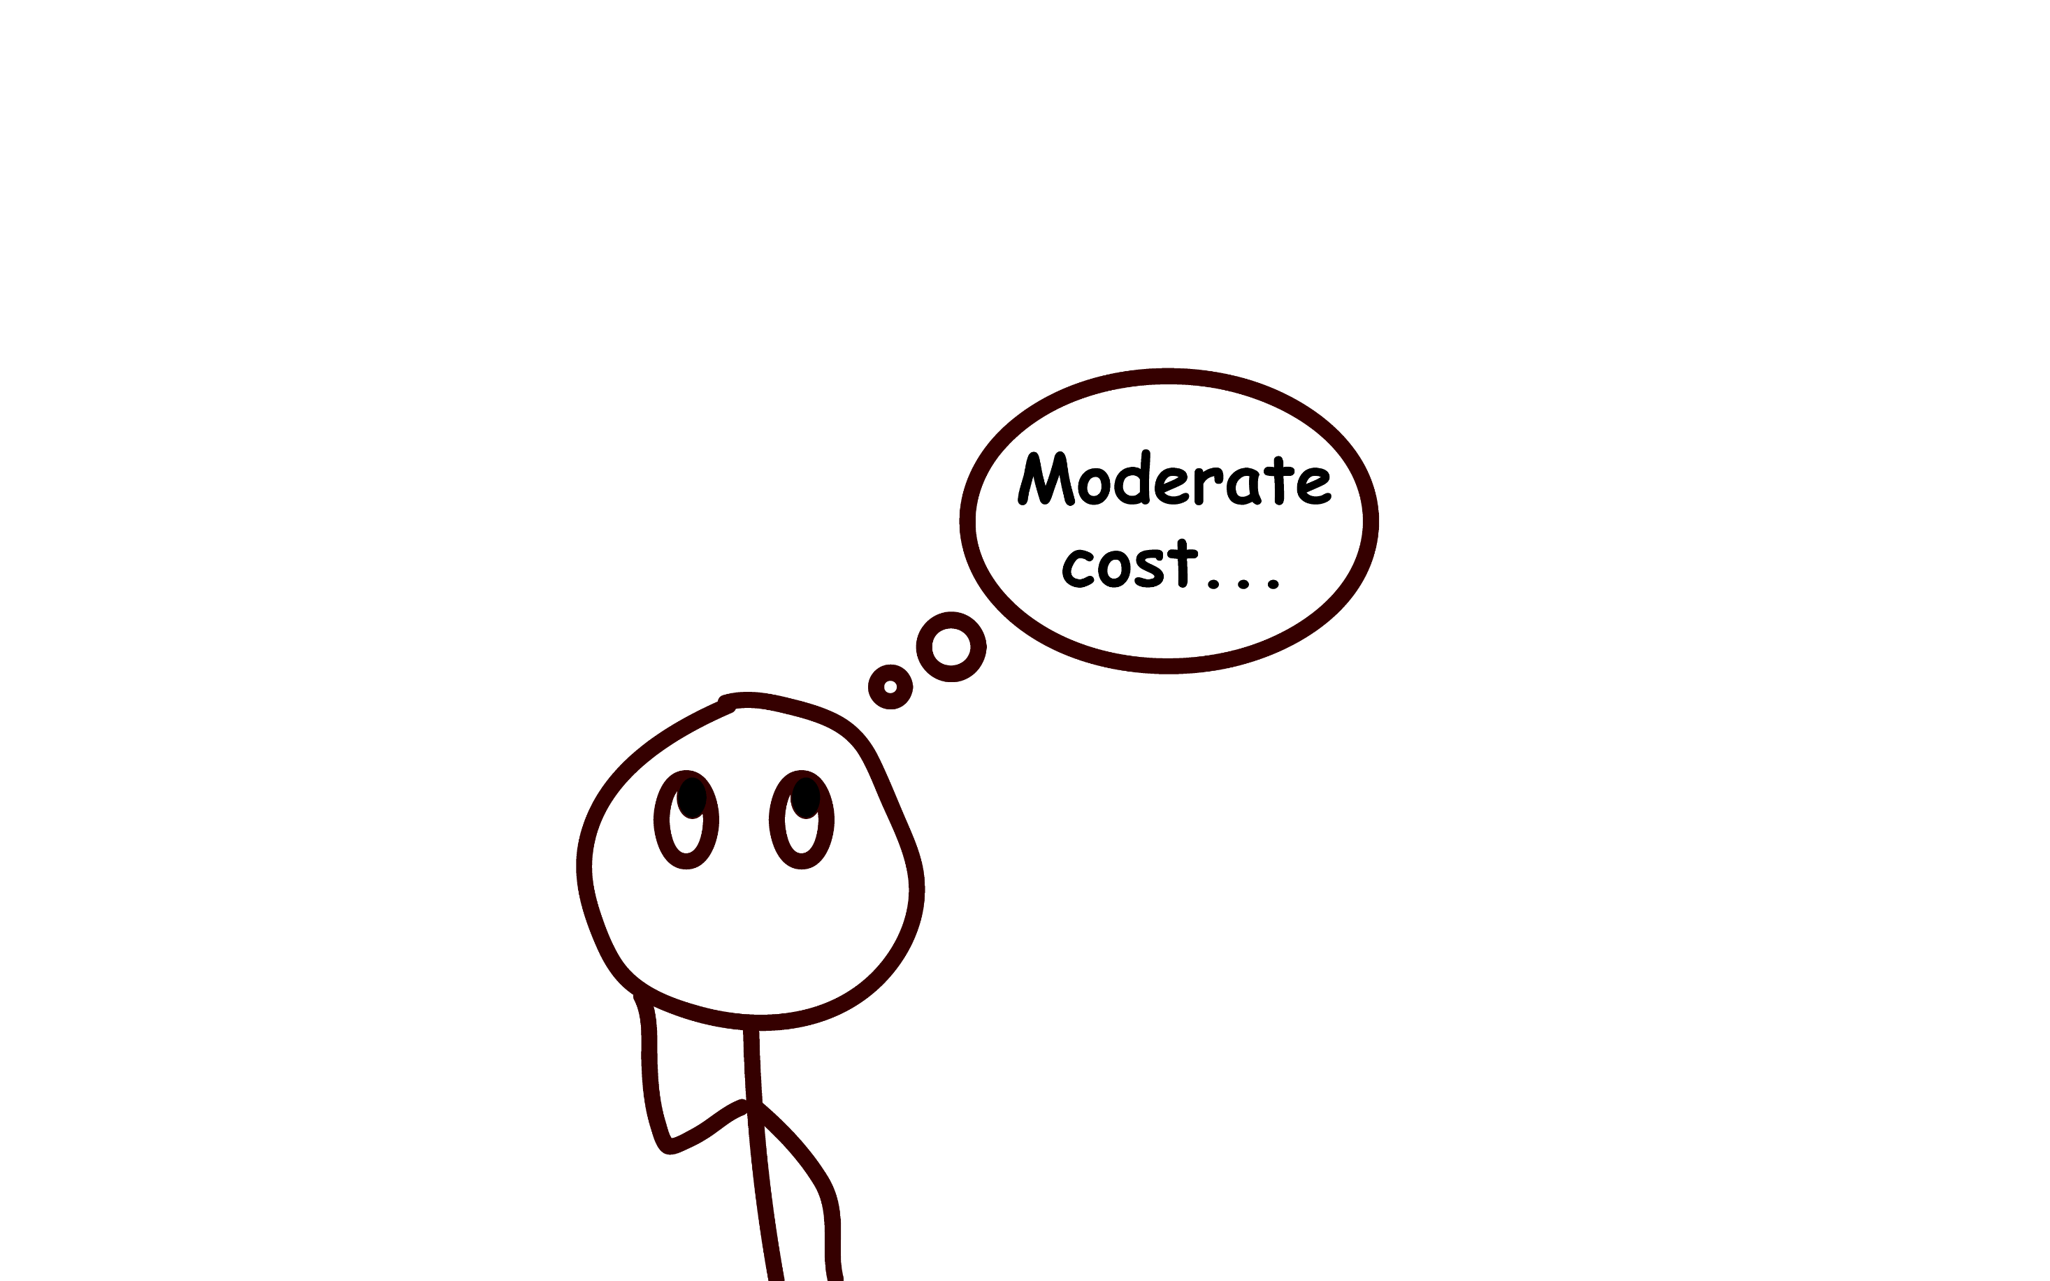


Slide 12
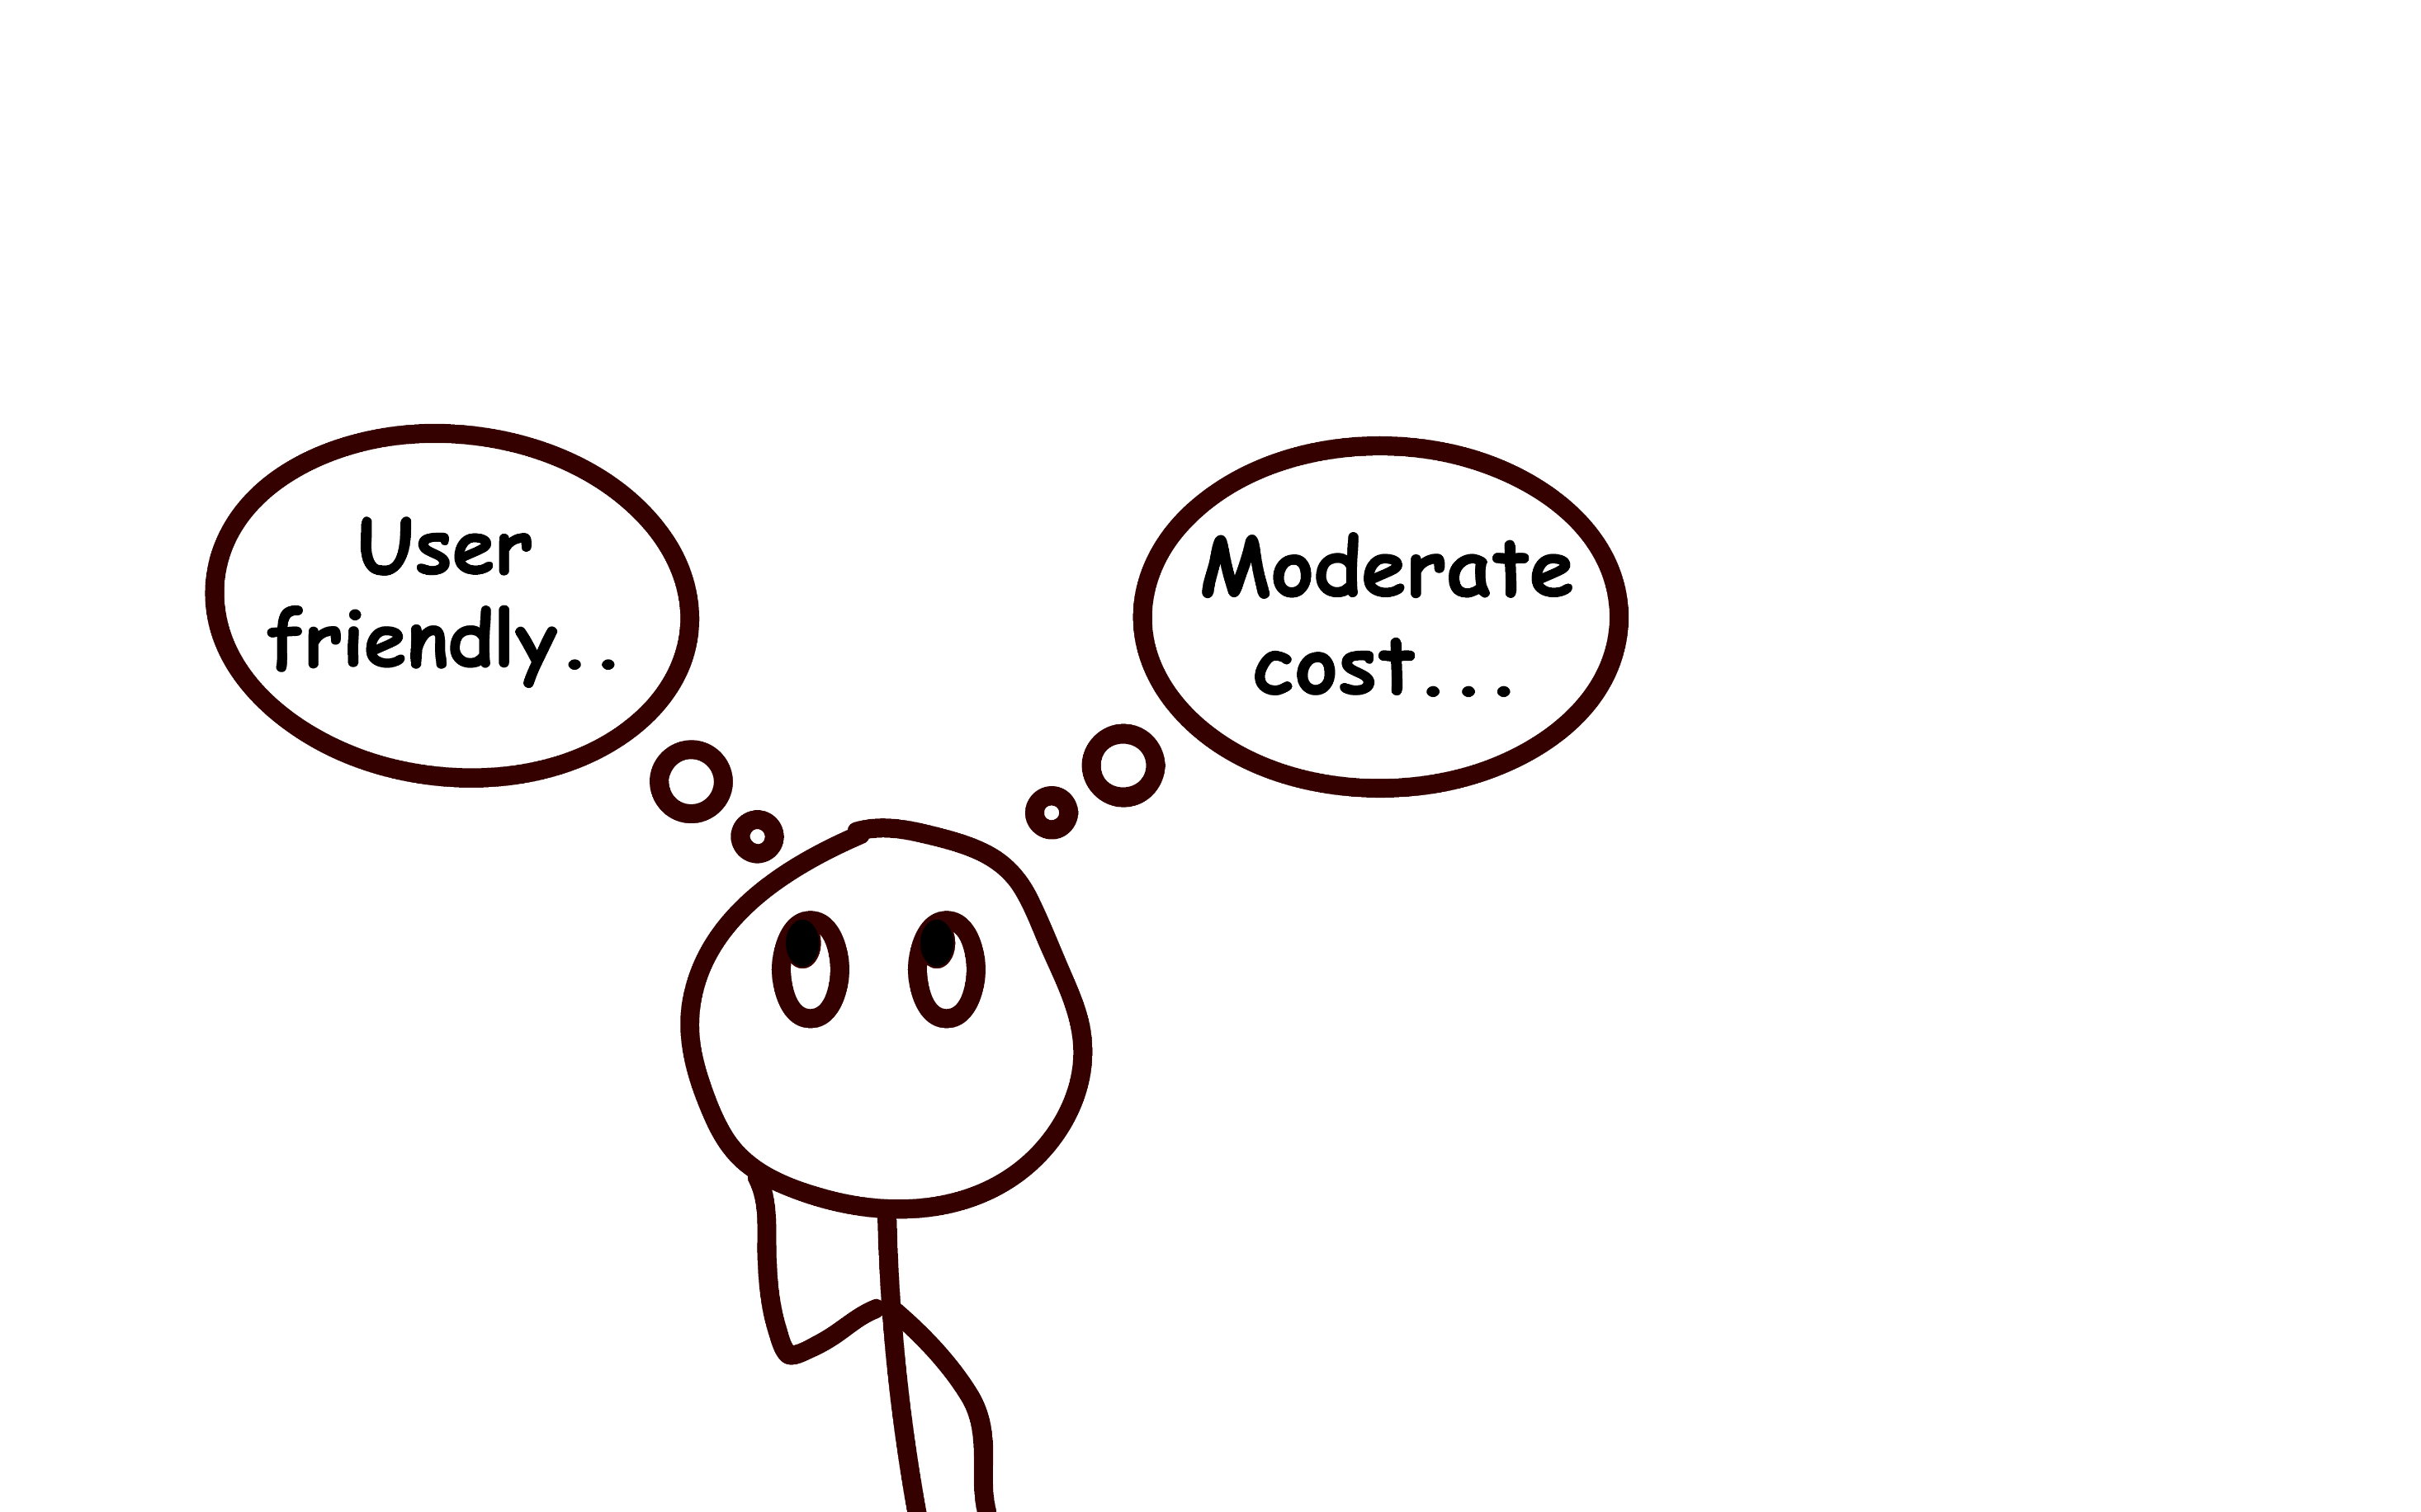


Slide 13
